Slide 1
CGSim: A Simulation Framework for Large Scale Distributed Computing Environment
Presenter: Sairam Sri Vatsavai on behalf of Redwood project
11/17/2025
The 16th International Workshop on Performance Modeling, Benchmarking and Simulation of High Performance Computer Systems
Notes:
Good morning everyone. I’m Sairam Sri Vatsavai from Brookhaven National Lab, and today I’ll be presenting CGSim, a simulation framework for large-scale distributed computing environments. This work is part of a Redwood collaboration, under the DOE Office of Science. Our goal with CGSim is to enable accurate, scalable, and data-driven simulation of distributed infrastructures like the Worldwide LHC Computing Grid.

Slide 2
Outline
Background
CGSim Framework
Architecture Overview
Features
Evaluation
Calibration Results
Scalability Analysis
Conclusions
Notes:
Here is the outline of my talk

Slide 3
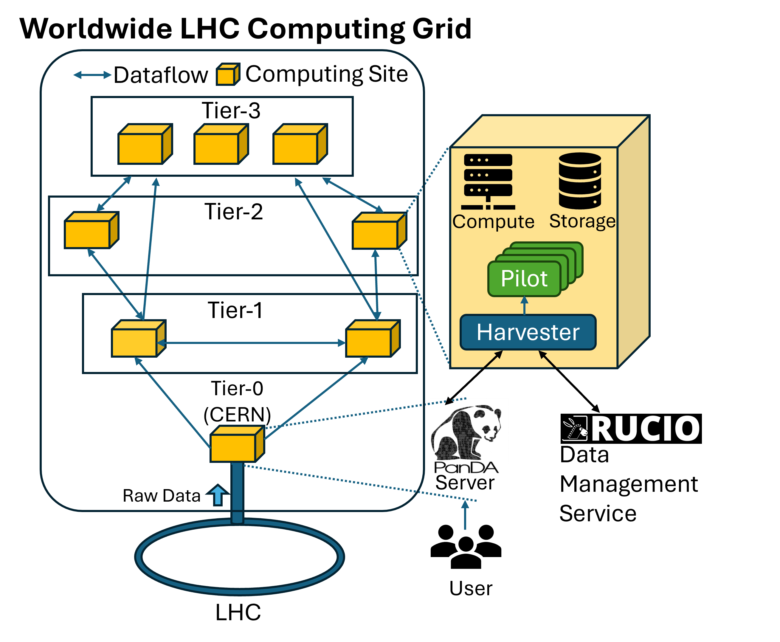
The Worldwide LCG System (WLCG)
LHC: Large Hadron Collider
PanDA: Management System
Rucio: Data Management Service
Roughly 200 sites globally
Rucio manages over 1 EB data
Notes:
Let’s start with some background. The Worldwide LHC Computing Grid, or WLCG, forms the backbone of data processing for CERN’s Large Hadron Collider experiments such as ATLAS. It connects about 200 computing sites worldwide, organized into tiers. Data from the LHC flows from Tier-0 (CERN) to Tier-1 and Tier-2 centers, and eventually to Tier-3 sites for user-level analysis. Two key systems orchestrate this workflow: PanDA for workload management and Rucio for data management — together handling more than 1 exabyte of scientific data.
Simulating such a complex, globally distributed system is highly valuable because a simulator can provide a controlled environment to evaluate new scheduling strategies, explore “what-if” scenarios, and gain insights into system-level performance and scalability. This i

Slide 4
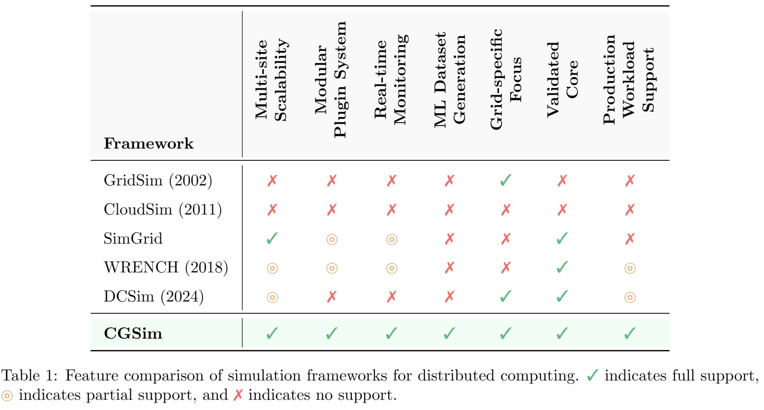
Prior Work
Notes:
Simulation of such infrastructures isn’t new, but existing tools have limitations. As shown in this comparison table, earlier frameworks like GridSim (2002), CloudSim (2011), SimGrid, WRENCH, and DCSim cover some aspects like scalability or modularity, but none provide all of these together:
multi-site scalability,
plugin-based modularity,
dataset generation for ML,
grid-specific validation, and
production workload support. CGSim was designed to bring all these together in a unified, validated, and extensible framework.”

Slide 5
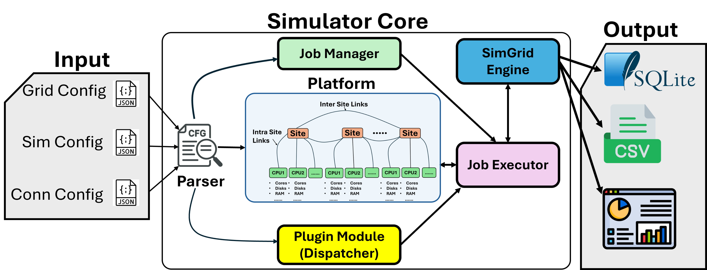
Computing Grid Simulator (CGSim)
Notes:
This is the architecture and operational flow of our simulation environment. It shows how data is ingested, processed, simulated, and monitored to produce various performance metrics. Lets start on the left hand side.The input to CGSim are json config files. These contain information on the grid configuration, site connection and simulation environment. This information is fed to the parser, The parser uses site information to setup the distributed computing platform shown at the center and feeds historical jobs to the job manager. Moving on to the top we have job manager, this component is responsible for organizing and queuing the simulation Jobs that need to be run. These Jobs are then passed to a job executor which works with dispatcher. The Dispatcher assigns these jobs to available resources within our simulation platform. CGSim has modular plugin architecture which allows the integration and evaluation of different job dispatching or allocaton strategies. The job executor runs the jobs on the simulated platform as they come in. The SimGrid Engine executes these simulations, modeling the behavior of the jobs on the defined platform configuration. The simulation generates various outputs, as indicated at the right. These include crucial performance metrics like cpu consumption time rtc and dynamic state of the system This output data is stored in SQLite database, CSV Finally, on the right, we have an Interactive Monitoring System.

Slide 6
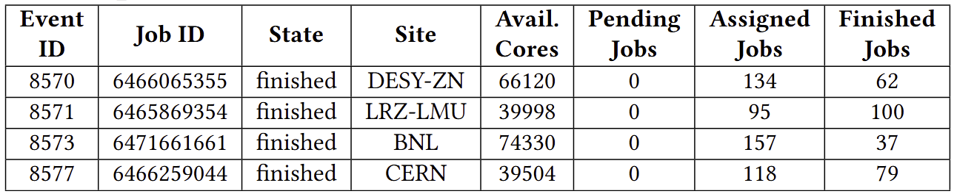
CGSim Features: Generating High Fidelity Training Dataset
CGSim
Track
System State
Historical Context Features
User Jobs
Job Lifecycle Updates
Site Load and Availability
Job Lifecycle Updates
Queue Status and System Load
Resource Availability
job_state
job_update_timestamp
num_queued_jobs
num_running_jobs
total_queued_cores
total_running_cores
pending_input_data
pending_output_data
Available_cores
Available_storage
Representative sample of event-level monitoring data captured by CGSim
Notes:
important capability of CGSim is its ability to generate high-fidelity, event-level datasets that can be used for machine-learning-based performance modeling.
During a simulation, CGSim continuously records the state of the system and the lifecycle of every job as it progresses through the grid. This includes detailed metrics such as:
the number of queued and running jobs,
total queued and running cores,
available cores and storage at each site,
pending input and output data sizes, and
job-specific timestamps and states.
By capturing these features over time, CGSim provides a rich historical context that reflects how workloads, resources, and network conditions evolve throughout a simulation. These records form a structured, high-resolution dataset that can be directly used to train predictive or surrogate models
— for example, models that forecast queue times, estimate job completion, or optimize scheduling decisions.
In short, this feature makes CGSim not just a simulator, but also a data-generation engine for AI-driven infrastructure research, bridging the gap between traditional system simulation and modern data analytics

Slide 7
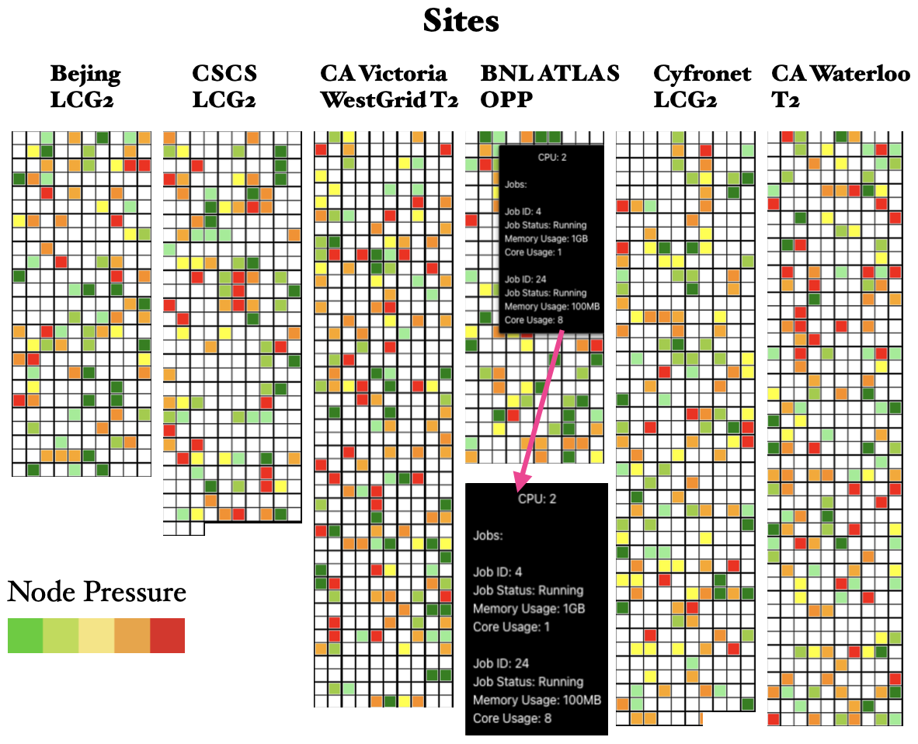

Plugin Mechanism and Visualization
Steps to Create a Plugin in CGSim
1
Define Custom Plugin Class
2
Inherit Abstract Dispatcher Interface
3
Implement Required Methods
4
Compile as Shared Library
5
Load through Simulation Config
Concrete detail and examples available at: https://atlasgridsim.web.cern.ch/plugin_support
Notes:
Now let’s look at how CGSim enables users to extend the simulator through its plugin mechanism
On the left, I’ve summarized the five simple steps needed to create a plugin in CGSim.
Step 1: You start by defining a custom plugin class — this is your own scheduling or allocation strategy that you want to test.
Step 2: You inherit the abstract dispatcher interface that CGSim provides. This base class defines the structure your plugin will follow and ensures compatibility with the simulator.
Step 3: You then implement the required methods, such as assignJob() and getResourceInformation(), which control how jobs are mapped to resources and how site information is accessed.
Step 4: Once your code is ready, you compile it as a shared library — for example, a .so file — so that CGSim can dynamically load it at runtime.
Step 5: Finally, you load the plugin through the simulation configuration file. The simulator automatically links your plugin and executes your logic during simulation.
This modular design makes CGSim extremely flexible — researchers can experiment with new scheduling or data-movement policies without modifying the simulator core.
On the right, you see how this ties into the visualization dashboard. Each grid of colored squares represents computing sites across the Worldwide LHC Grid. The color indicates node pressure — from green (light load) to red (heavy load). This real-time view lets users immediately observe how their plugin affects job distribution and site utilization across the grid.
Together, the plugin system and visualization make CGSim both customizable and introspective — letting users design, test, and observe new ideas within a simulated environment

Slide 8
Calibration Methodology
Abstract view of Simulator
Input Job Fields
Calibrate
pandaid, creationtime, computingsite,
destinationse, sourcesite, workload,
corecount, ninputdatafiles, inputfilebytes, noutputdatafiles, Outputfilebytes
Computing Grid Definition
Historical
Jobs
Simulator
Output
Per Job Execution
Metrics
Site Definition
"AGLT2_MERGE": {
"RSE": {
"AGLT2_CALIBDISK": "269.54",
"AGLT2_DATADISK": "11239.99",
"AGLT2_LOCALGROUPDISK": "350.00",
"AGLT2_SCRATCHDISK": "170.00"
},
"GFLOPS": 4679040, // compute capability
"CPUCount": 292,
"CPUSpeed": []-> Identified calibration parameter
}
Dispatcher
Δ_{exe_time}= |Sim_{exe_time} - His_{exe_time}|
Job Execution Time
Job Queue Time
Job Wall Time
Creation
Time
Start
Time
End
Time
Simulator Output Fields
JOB_ID, SITE, CPU, STATUS, CORES, FLOPS, IO_SIZE, IO_TIME, CPU_CONSUMPTION_TIME
Data Movement & Compute Availability
Preprocess
Time
CPU
Consumption
Time
Postprocess
Time

Slide 9
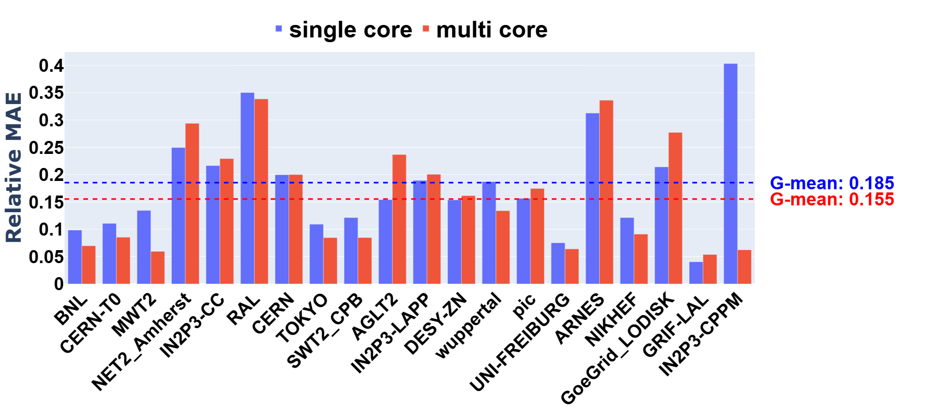
Evaluation: Calibration Results
We simulated the 50 most-frequent job processing sites based on January 2025 user jobs.
Only finished jobs from the historical data were included.
Relative Mean Absolute Error:
Before calibration: 76 % for single-core jobs and 96 % for multi-core jobs.
After calibration: 17 % for both single-core and multi-core jobs.
Calibration was performed using random search using 1000 jobs per site. Calibration parameter was CPU speeds at each site.
Results presented are for input consisting of 3k jobs for each site.
Note: Only 20 sites out of 50 are plotted for better visualization.
Notes:
Before discussing the results, a quick note on the calibration process — we used real ATLAS PanDA job logs to tune simulation parameters by minimizing the gap between simulated and observed job execution times. Through sensitivity analysis, we found that CPU core speed was the most influential factor. We tested several optimization techniques — random search, Bayesian optimization, and CMA-ES — and found random search gave the best accuracy across sites
We evaluated 50 frequent ATLAS sites using finished jobs from January 2025. Before calibration, the relative mean absolute error was 76 % for single-core and 96 % for multi-core jobs. After calibration, the error dropped to about 17 % for both — a drastic improvement. Calibration used random search over CPU speeds with 1,000 jobs per site. These results confirm CGSim’s ability to reproduce realistic performance trends across diverse sites.

Slide 10
Evaluation: Scalability Analysis
Single Site Scaling
Multi-Site Scaling
Experiments were performed on an Intel i9 system with 64 GB of memory.
The scalability analysis is performed using the historical PanDA job records collected from production WLCG operation.
The simulator demonstrates strong architectural efficiency when scaling across multiple sites, with performance stabilizing after initial setup overhead, enabling effective distributed simulations.
Notes:
Next, we analyzed scalability and performance characteristics of CGSim using real PanDA production job records.
We ran all experiments on a commodity Intel i9 system with 64 GB of memory. Each simulated site was configured with between 100 and 2000 cores, consistent with real WLCG site definitions.
The left plot shows single-site scaling. As we increase the number of jobs, runtime grows sub-linearly — under 100 seconds for 1,000 jobs and around 2,500 seconds for 10,000. This demonstrates efficient event scheduling within the SimGrid engine and minimal per-job overhead.
On the right, multi-site scaling shows how runtime increases with the number of simulated sites. We see near-linear growth up to 50 sites, stabilizing after initial setup. This confirms that CGSim distributes workloads effectively with low inter-site synchronization costs.
In terms of efficiency, overall simulation throughput remains above 90 %, even at 50 sites — which indicates excellent architectural scaling.
Together, these results show that CGSim can model WLCG-scale infrastructures with high fidelity and low computational cost, even on standard hardware.

Slide 11
Conclusions
CGSim is a scalable, and extensible simulation framework built on the SimGrid engine.
It has broad range of applicability such as multi-site modeling, modular plugin integration, and real-time visualization of large-scale distributed environments.
Enables generation of event-level datasets for AI-driven performance modeling, bridging traditional simulation with data-centric methods.
We showed calibration of the WLCG system and validating fidelity across 50 sites.
Future work: scaling to the full WLCG infrastructure, developing machine learning surrogates for rapid inference, and performing quantitative benchmarking against existing simulators.
Notes:
It has broad range of applicability, such as Enables generation of goes before In this presentation we showed the calibration of the WLCG system and Future Work

Slide 12








Thank you
Paper
Paper DOI: https://dl.acm.org/doi/10.1145/3731599.3769277
Author list: Sairam Sri Vatsavai, Raees Khan, Kuan-Chieh Hsu, Ozgur O. Kilic, Tatiana Korchuganova, Paul Nilsson, Frédéric Suter, Sankha Dutta, Yihui Ren, David K. Park, Joseph Boudreau, Tasnuva Chowdhury, Shengyu Feng, Jaehyung Kim, Scott Klasky, Tadashi Maeno, Verena Ingrid Martinez Outschoorn, Norbert Podhorszki, Wei Yang, Yiming Yang, Shinjae Yoo, Alexei Klimentov, Adolfy Hoisie
This work is supported by the U.S. Department of Energy, Office of Science, Office of Advanced Scientific Computing Research under Award Number DE-SC-0012704.
GitHub

